Slide 1

Data Warehousing Architecture and ETL Process
CSA1607 - DATA WAREHOUSING AND DATA MINING
Presented By-
Surya Krishna Teja Yandra
(192425065)

Slide 2
Data Warehouse
A data warehouse is a centralized repository that stores data from multiple sources.
It is designed for reporting, analysis, and decision-making.
It stores historical data rather than day-to-day transaction data.
It provides a single, consistent view of organizational data.

Slide 3
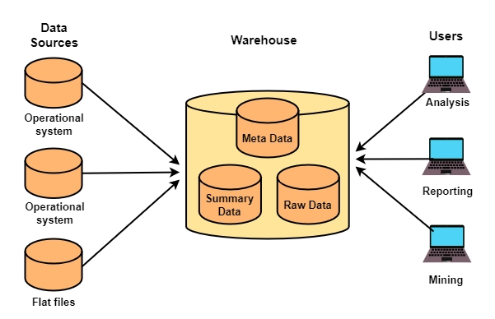
Data Warehouse Architecture

Slide 4
ETL Process
Extract
Collects data from databases, files, and applications.
Transform
Cleans, filters, and converts data into a standard format.
Load
Stores the processed data in the data warehouse.
Benefits
Improves data quality
Removes duplicate data
Supports accurate analysis

Slide 5
Applications
Banking: Customer transaction analysis
Retail: Sales and inventory management
Healthcare: Patient record analysis
E-commerce: Customer behavior analysis
Education: Student performance analysis

Slide 6
Advantages
Faster reporting
Better decision-making
Historical data analysis
Improved business intelligence
Easy access to integrated data

Slide 7
Conclusion
Data warehouses organize data from multiple sources into a central repository.
ETL prepares data for accurate storage and analysis.
Organizations use data warehouses to generate reports, analyze trends, and make informed business decisions.

